Slide 1
Area of a circle
Perimeter, area and volume

Slide 2
how to use Oak lessons

Slide 3
I can understand the derivation of the area of a circle.

Slide 4
The area is the size of the surface and states the number of unit squares needed to completely cover that surface.
The radius is any line segment that joins the centre of a circle to its edge.
The diameter of a circle is any line segment that starts and ends on the edge of the circle and passes through the centre.

Slide 5

Area of a circle
Estimating areas of circles
Deriving the formula to calculate areas of circles

Slide 6
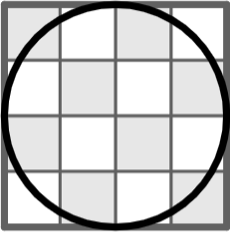
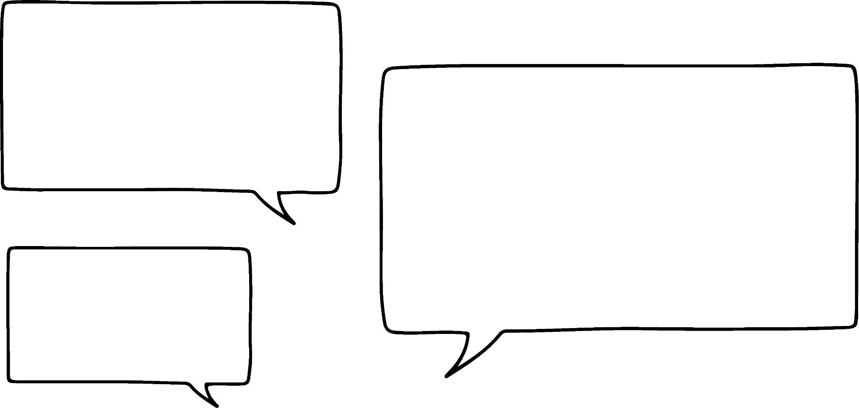

Estimating areas of circles
Laura is estimating the area of the circle.
If I overlay the circle onto a grid then I could estimate the area by counting unit squares.
1 unit

Slide 7
Estimating areas of circles
Laura is estimating the area of the circle.
There are 16 squares in total.
The circle takes up less space than that so its area must be less than 16 units².
4
total number of squares = 16
4

Slide 8
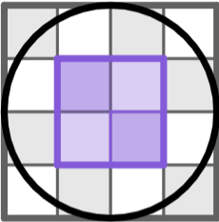
Estimating areas of circles
Laura is estimating the area of the circle.
There are 4 complete squares inside the circle.
The circle takes up more space than that so its area must be greater than 4 units².
total number of squares = 16
number of square inside = 4

Slide 9
Estimating areas of circles
Laura is estimating the area of the circle.
So the area of the circle must be between 4 and 16 units².
total number of squares = 16
number of square inside = 4
4 units² < area of circle < 16 units²

Slide 10
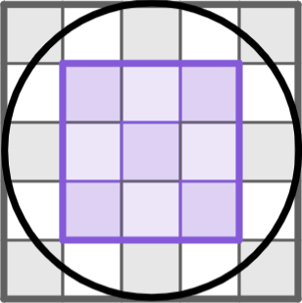

Estimating areas of circles
Which range would the area of the circle be in?
between 0 units² and 9 units²
between 9 units² and 25 units²
between 25 units² and 36 units²
1 unit

Slide 11

Estimating areas of circles
Jun is using reasoning to think about the area of a circle.
r
Areas are normally calculated by multiplying two perpendicular lengths. But I can only see one length on the circle.

Slide 12
Estimating areas of circles
Jun is using reasoning to think about the area of a circle.
r
r
The radius in a circle is the same in every direction. So I could draw on another radius that is perpendicular to the first one.

Slide 13
Estimating areas of circles
Jun is using reasoning to think about the area of a circle.
r
r
r
r
If I multiplied the two radii then I would have the area of a square whose length is equal to the radius.

Slide 14
Estimating areas of circles
Jun is using reasoning to think about the area of a circle.
r
r
r²
r
r
The area of this square would be equal to the radius squared.

Slide 15
Estimating areas of circles
Jun is using reasoning to think about the area of a circle.
r
r
r²
r
r
The area of the circle is greater than the area of 1 square.
r²
< area of circle

Slide 16
Estimating areas of circles
Jun is using reasoning to think about the area of a circle.
r
r
r²
r
r
The area of the circle looks convincingly greater than the area of 2 squares.
2r²
< area of circle

Slide 17
Estimating areas of circles
Jun is using reasoning to think about the area of a circle.
r
r
r²
r
r
It’s difficult to see whether the area of the circle is less than or greater than the area of 3 squares.
2r²
< area of circle

Slide 18
Estimating areas of circles
Jun is using reasoning to think about the area of a circle.
r
r
r²
r
r
The circle is fully inside 4 squares, so its area is less than the area of 4 squares.
2r²
4r²
< area of circle <

Slide 19
Estimating areas of circles
Jun is using reasoning to think about the area of a circle.
r
r
r²
r
r
So the area of the circle must be between 2 and 4 lots of the radius squared.
2r²
4r²
< area of circle <

Slide 20
Estimating areas of circles
area of 2 squares = 72 m²
6 m
6 m
36 m²
area of 4 squares = 144 m²
72 m²
< area of circle <
144 m²
6 m
Jun uses his conclusion to estimate the area of the circle.
The length of the square is the same as the radius.
The area of the circle is between 2 and 4 times the area of the square.
The area of the square is 36 m².

Slide 21
Estimating areas of circles
The area of the circle is between 2 and 4 times the area of the square.
Which is the most appropriate range for the area of the circle?
5 cm
5 cm
Between 10 cm² and 20 cm²
Between 25 cm² and 50 cm²
Between 50 cm² and 100 cm²

Slide 22
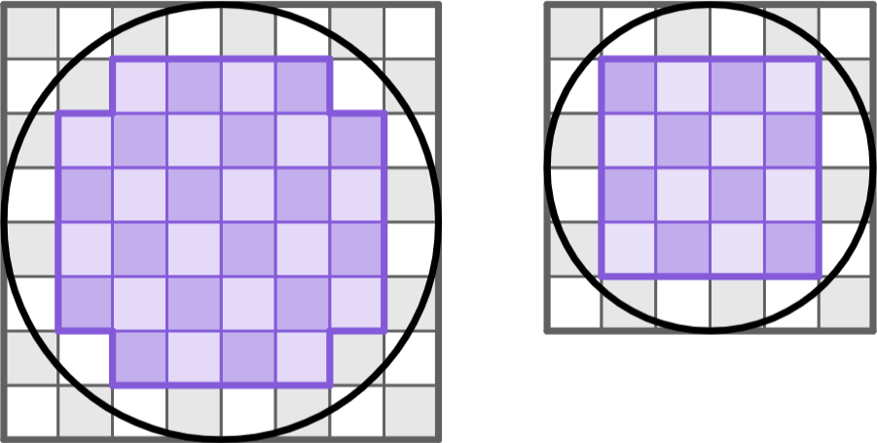
Estimating areas of circles
1) For each diagram: i) find the number of complete squares inside the circle; ii) find the total number of squares; iii) complete the range for the area of the circle.
a)
b)
i) number of squares inside =
ii) total number of squares =
iii) units² < area of circle < units²
i) number of squares inside =
ii) total number of squares =
iii) units² < area of circle < units²

Slide 23
a)
area = 9 m²
b)
4 m
c)
10 m
area = A m²
area = B m²
area = C m²
area of 2 squares = m²
area of 2 squares = m²
area of 2 squares = m²
area of 4 squares = m²
area of 4 squares = m²
area of 4 squares = m²
Estimating areas of circles
2) Use the information provided to fill in the gaps.
The area of each circle is between 2 and 4 times the area of its accompanying square.
< A <
< B <
< C <

Slide 24
Estimating areas of circles
1) For each diagram: i) find the number of complete squares inside the circle; ii) find the total number of squares; iii) complete the range for the area of the circle.
a)
b)
16
32
i) number of squares inside =
ii) total number of squares =
iii) units² < area of circle < units²
i) number of squares inside =
ii) total number of squares =
iii) units² < area of circle < units²
36
64
16
36
32
64

Slide 25
a)
area = 9 m²
b)
4 m
c)
10 m
area = A m²
area = B m²
area = C m²
18
32
200
area of 2 squares = m²
area of 2 squares = m²
area of 2 squares = m²
36
64
400
area of 4 squares = m²
area of 4 squares = m²
area of 4 squares = m²
18
36
32
64
200
400
Estimating areas of circles
2) Use the information provided to fill in the gaps.
The area of each circle is between 2 and 4 times the area of its accompanying square.
< A <
< B <
< C <

Slide 26
Area of a circle
Estimating areas of circles
Deriving the formula to calculate areas of circles

Slide 27
Deriving the formula to calculate areas of circles
The formula A = πr² can be derived by splitting a circle into sectors.
r
r
half of the circumference = πr
half of the circumference = πr
circumference = 2πr

Slide 28
Deriving the formula to calculate areas of circles
Each time the circle is split into more sectors, the new shape becomes more and more like a parallelogram.
r
r
half of the circumference = πr
half of the circumference = πr

Slide 29
Deriving the formula to calculate areas of circles
Each time the circle is split into more sectors, the new shape becomes more and more like a parallelogram.
r
r
half of the circumference = πr
half of the circumference = πr

Slide 30
Deriving the formula to calculate areas of circles
Each time the circle is split into more sectors, the new shape becomes more and more like a parallelogram.
r
r
half of the circumference = πr
half of the circumference = πr

Slide 31
Deriving the formula to calculate areas of circles
Each time the circle is split into more sectors, the new shape becomes more and more like a parallelogram.
r
r
half of the circumference = πr
half of the circumference = πr

Slide 32
Deriving the formula to calculate areas of circles
area of circle = π × radius²
area of parallelogram = base × height
A = πr²
A =
πr
×
r
A = πr²
r
r
half of the circumference = πr
half of the circumference = πr

Slide 33
Deriving the formula to calculate areas of circles
The area of this parallelogram is equal to the area of the circle.
Find the area of each shape.
3 cm
3 cm
3π cm
area of parallelogram = base × height
area of circle = π × radius²
= 3π × 3
= π × 3²
= 9π
cm²
= 9π
cm²

Slide 34
Deriving the formula to calculate areas of circles
The area of the circle is equal to the area of the parallelogram.
6 cm
6 cm
C
What is the circumference of the circle in terms of π?
12π cm

Slide 35
Deriving the formula to calculate areas of circles
The area of the circle is equal to the area of the parallelogram.
6 cm
6 cm
b
12π cm
How long is the base of the parallelogram?
6π cm

Slide 36
Deriving the formula to calculate areas of circles
The area of the circle is equal to the area of the parallelogram.
6 cm
6 cm
6π cm
12π cm
What is the area of each shape in terms of π?
36π cm²

Slide 37
Deriving the formula to calculate areas of circles
1) Each circle overlaps with a square. For each question:
i) Find the area of the square.
ii) Find the area of the circle in terms of π.
a)
b)
c)
4 cm
7 cm
9 cm
i) area of square =
i) area of square =
i) area of square =
ii) area of circle =
ii) area of circle =
ii) area of circle =

Slide 38
Deriving the formula to calculate areas of circles
2) Each parallelogram is made from the sectors of one of the three circles. The diagrams are not drawn to scale.
10 m
20 m
10π m
5π m
C = 10π m
20 m
20 m
a) Match each parallelogram with the circle of the same approximate area.
b) Find the area of each circle in terms of π.

Slide 39
Deriving the formula to calculate areas of circles
1) Each circle overlaps with a square. For each question:
i) Find the area of the square.
ii) Find the area of the circle in terms of π.
a)
b)
c)
4 cm
7 cm
9 cm
i) area of square =
81 cm²
i) area of square =
16 cm²
i) area of square =
49 cm²
ii) area of circle =
81π cm²
ii) area of circle =
16π cm²
ii) area of circle =
49π cm²

Slide 40
Deriving the formula to calculate areas of circles
2) Each parallelogram is made from the sectors of one of the three circles. The diagrams are not drawn to scale.
10 m
20 m
10π m
5π m
C = 10π m
20 m
20 m
400π m²
25π m²
100π m²
a) Match each parallelogram with the circle of the same approximate area.
b) Find the area of each circle in terms of π.

Slide 41
Area of a circle
The area of a circle can be estimated by using squares.
A circle can be cut into sectors that are placed together to make a parallelogram.
The length of the parallelogram is half the circumference of the circle.
The height of the parallelogram is the radius of the circle.
The formula for the area of a circle can be derived from the area of this parallelogram.
The area of a circle can be calculated using the formula A = πr².

Slide 42

© Oak National Academy 2023.
Produced in partnership with Mathematics in Education and Industry.
Licensed on the Open Government Licence v3.0, except where otherwise stated. See Oak terms and conditions.

